Slide 1
Summary & Pilot Study
Midterm Exam
Hwang Jihyun
02221081

Slide 2
Understanding Big Data
(Week 02)
1. About Compiler

Slide 3

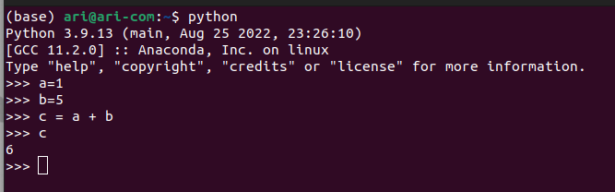
Install Python3 program
Run Python

Slide 4

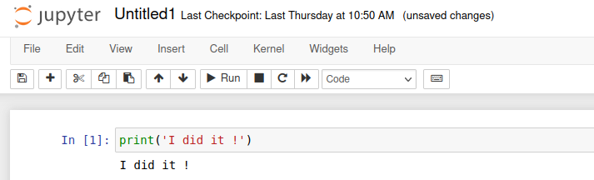
Install Jupyter Lab
Run Jupyter Notebook

Slide 5
Make my First Python code
(Week 03)
1. ABC of Python
2. How to crawl from COVID-19 sources
3. Database management system

Slide 6
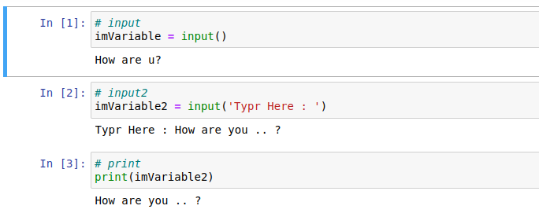
Grammars
1. input() & print()

Slide 7
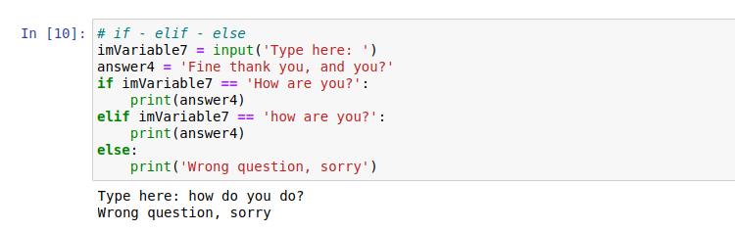
Grammars
2. if ~ else

Slide 8
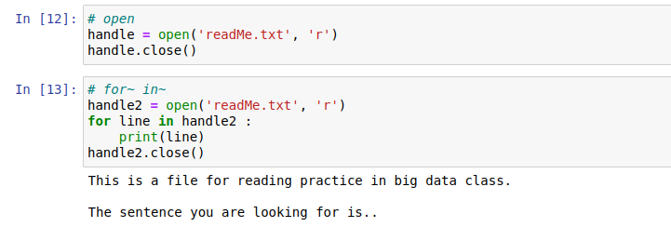
Grammars
3. open() & for ~ in ~

Slide 9
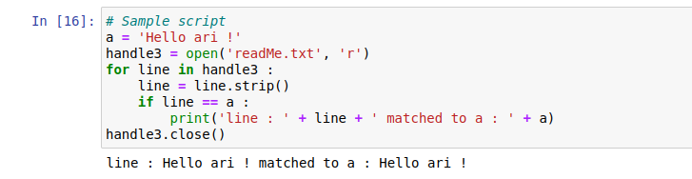
Sample Script

Slide 10

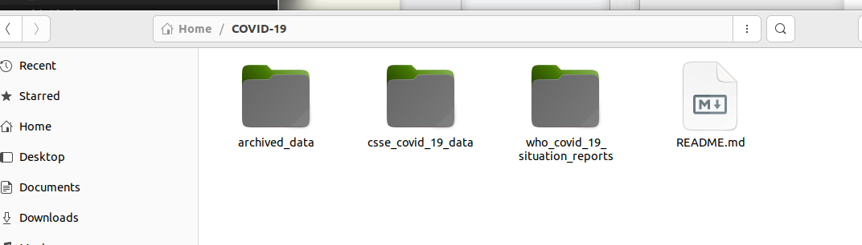
Install Git
Git clone COVID-19 Vaccination data

Slide 11
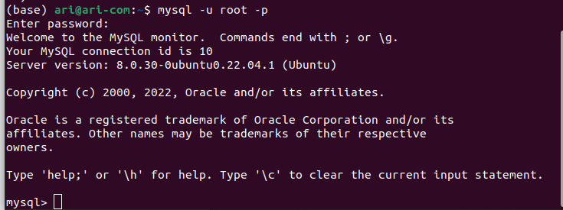
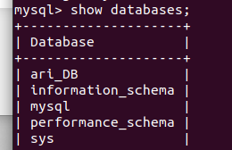
Install MySQL & Make Database

Slide 12
Supercomputer & Metaverse
(Week 04)
1. Pandas DataFrame

Slide 13
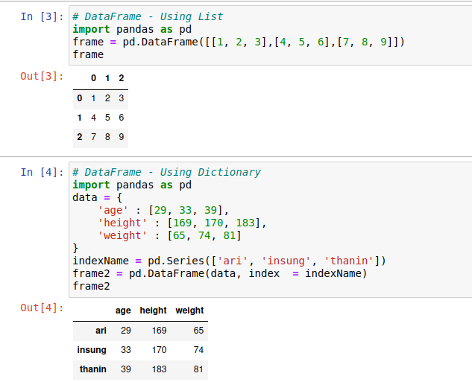
Create DataFrame

Slide 14
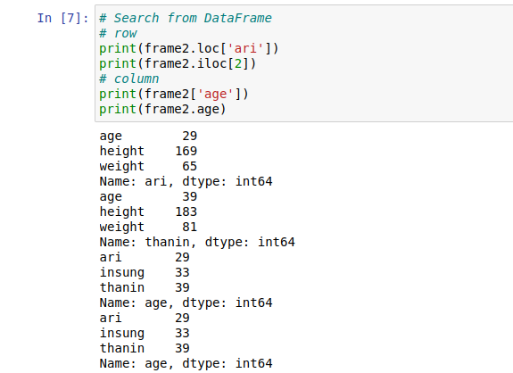
Search from DataFrame

Slide 15
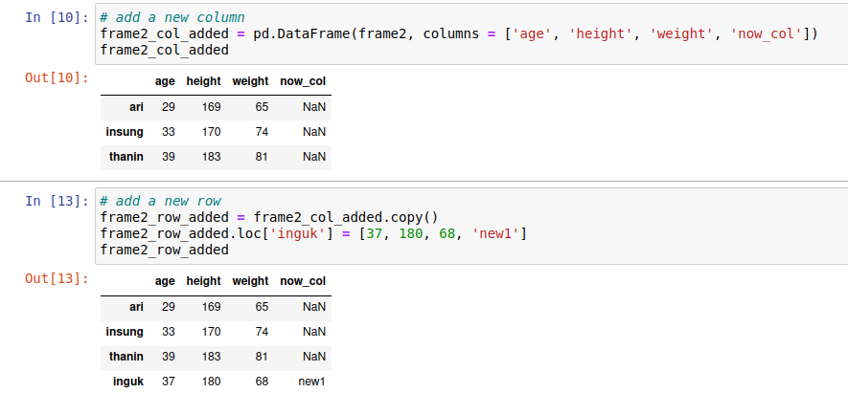
Add a new column & row

Slide 16
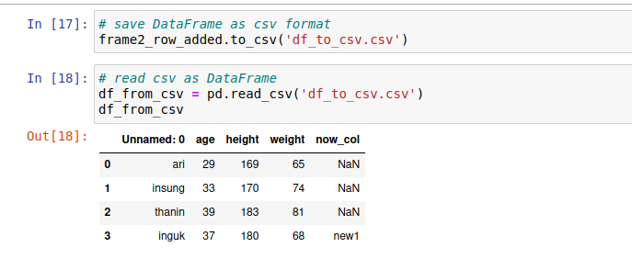
Save DataFrame as csv format &
Read csv as DataFrame

Slide 17
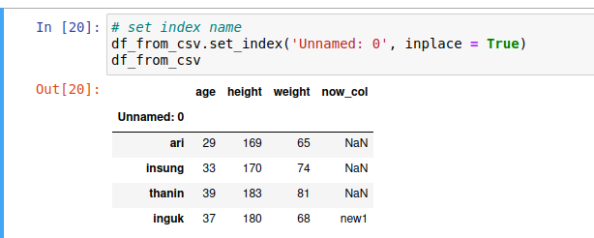
Set index name

Slide 18
Stock Market data & MySQL
(Week 05)
1. About Stock Market data
2. Connecting MySQL @ Python
3. Make my own table in MySQL

Slide 19
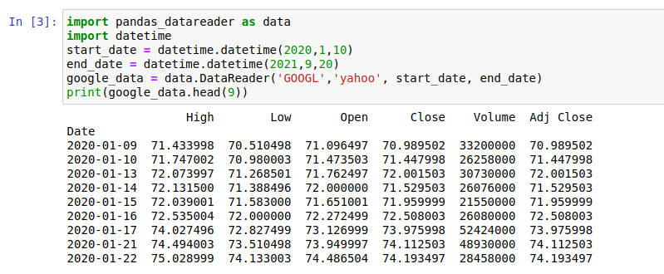
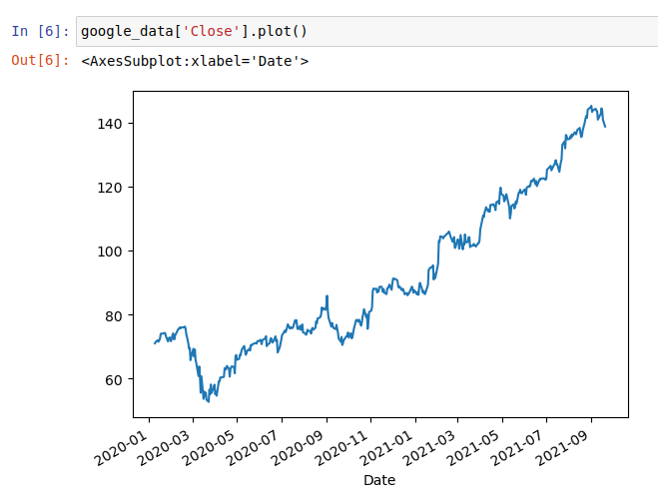
using Yahoo Finance @ python

Slide 20
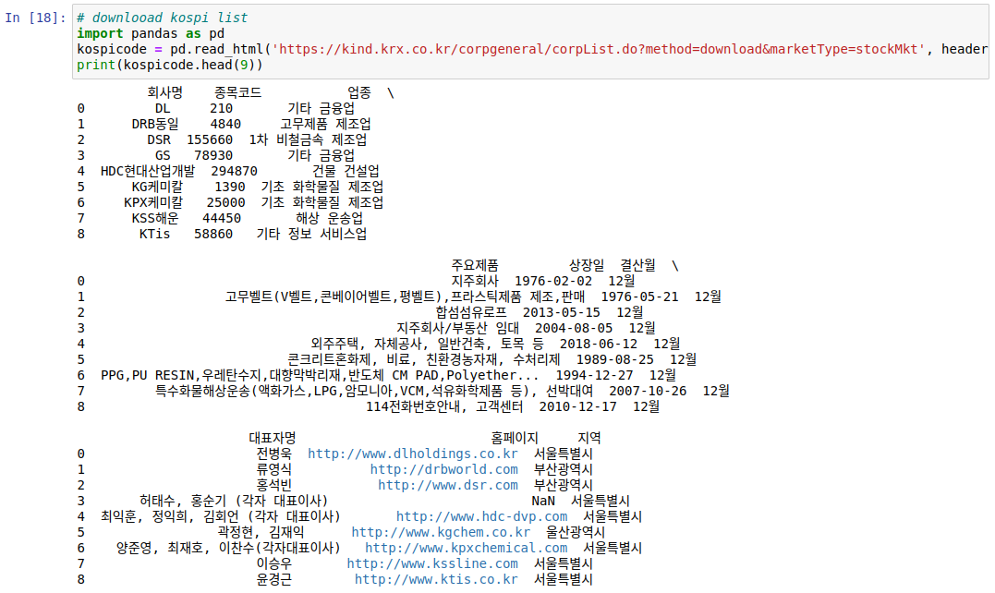
Download the KOSPI List

Slide 21

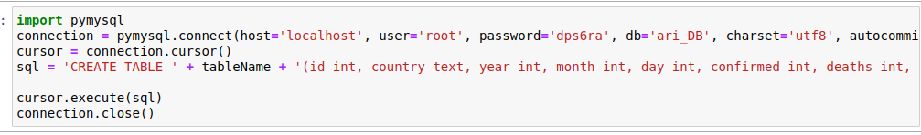
Connect to MySQL in Python

Slide 22
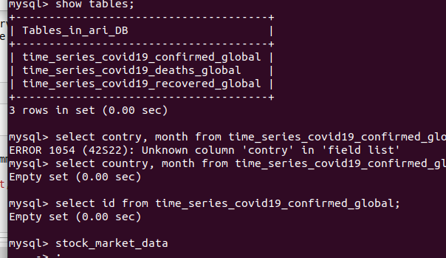
Create Connection & MySQL Table

Slide 23
COVID-19 &
Government response
1. Pandas DataFrame
2. Extract target information

Slide 24
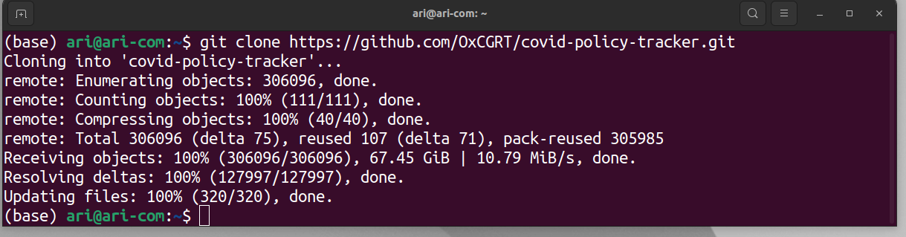
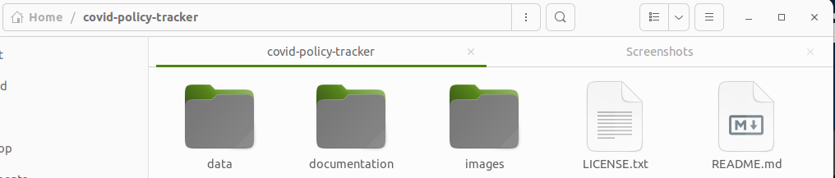
Download Data sets of OxCGRT

Slide 25
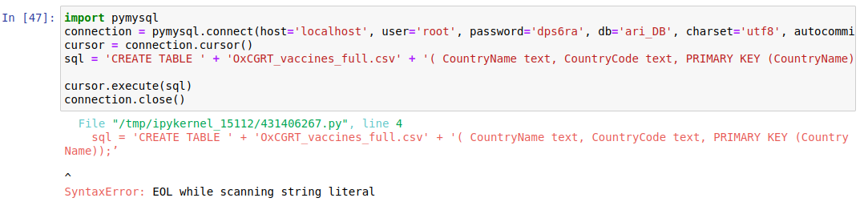
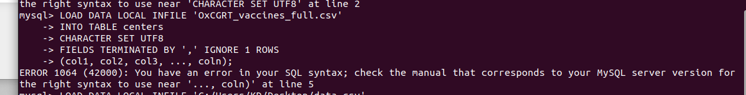
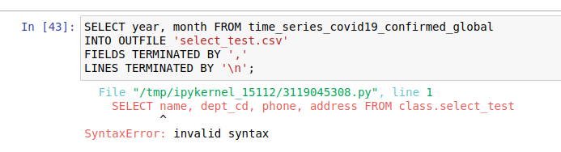
Perform a simple correlation analysis : Failed… :(

Slide 26
A rough plan of the pilot study
1. Study how to learn more about tasks that you couldn't complete before and use them in a variety of ways
2. Analysis of changes in the global exchange rate after COVID-19 and future prospects
3. Comparison of COVID-19 and Flu Trends

Slide 27

Thank You

